Slide 1
CRICKET
Lana Vučan 6.a

Slide 2
WHAT IS IT?
Cricket is a ball and stick game between two teams, each with 11 players. It is played on a turf (at least 60 m × 80 m) with a marked field (cca 20 m × 3 m). There is no time limit.

Slide 3
HOW IS IT PLAYED?
On each side of the field there is a narrow door (width 22.86 cm) of 3 pegs, 73 cm high. Teams take turns and first play as strikers, then as field guards. A striker has only two players on the court; each of them defends his goal from the ball with a stick, while the other players wait in line to enter the game. A player of the opposing team stands 20 m away with the ball.

Slide 4
The other players (field guards) are on the field, so they can catch the ball as quickly as possible if the striker bounces it with a stick. When the striker hits the ball, both strikers run towards the opposite goal at the same time. The more times they run between the gates, the more points they score for their team.

Slide 5
The striker is replaced by a new player:
if the pitcher knocks down the goal
- if the opposing players catch the ball in the air or throw the ball to each other and knock down the wicket (goal)before the striker arrives in front of them.

Slide 6
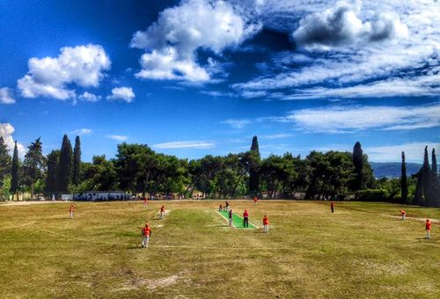
SOME INTERESTING FACTS
Cricket began to be played in England in the XIIIth century, and even today it is mostly played in the Commonwealth countries.
Cricket was played on Vis by English soldiers almost two hundred years ago, and a hundred years ago F. Bučar tried to domesticate it, but the game lasted only a few years.
Today there is a club in Zagreb, and at the end of 2002 cricket was renewed on Vis as well.
Cricket on Vis

Slide 7
THANKS FOR WATCHING!

